Slide 1



A GENETIC ALGORITHM FOR COMPOSING MUSIC
Presented by ABEERA AND NISHA

Slide 2
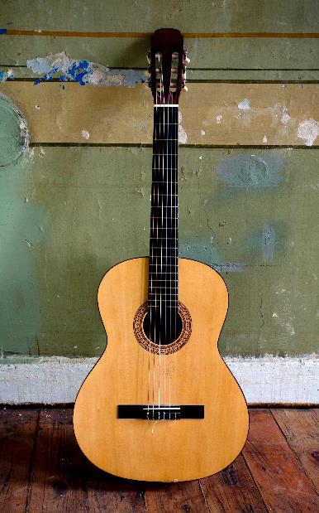
ALGORITHMS IN MUSIC
Algorithms for sound synthesis, sampling, recognition of musical works, as well as for music composition.
The first three activities naturally impose algorithms as a way of solving the problem
Genetic algorithms (GA) seems to be a suitable approach for generating musical compositions. Combination of genetic operators (mutation, selection and crossover) in some way simulates the innovative process (as real composing is), enabling continuous "improvement" of the obtained results.

Slide 3
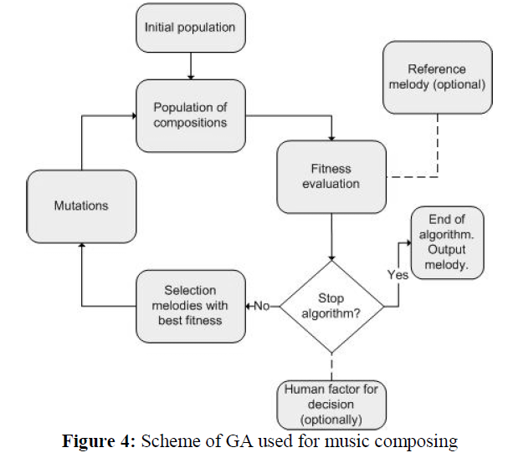
GENETIC ALGORITHM FOR MUSIC COMPOSING

Slide 4
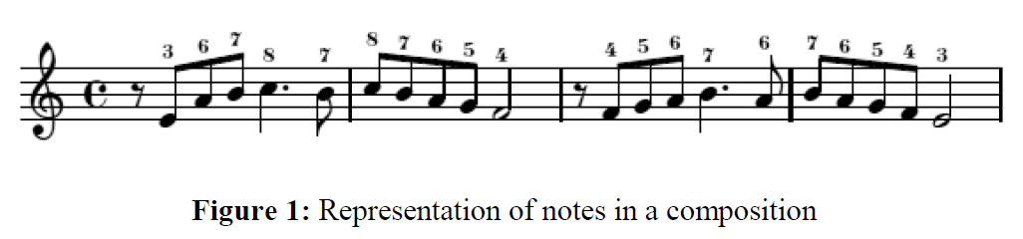
MUSIC TERMINOLOGY
NOTES
C-D-E-F-G-A-B
PITCH/
Pitch can be considered as a subjective feeling that the human ear hears, but also as an objective value (for example, the frequency of an appropriate sound wave).
TONE
OCTAVE
1 octave goes from one C to another C where difference between pitches is either 2f or ½ f.
The duration of the tone and frequency of these durations in the melody defines rhythm and basic unit of measurement - bar.
BARS
INTERVAL
Duration between two consecutive notes
Notes:
5 additional chords that include sharp chords.

Slide 5
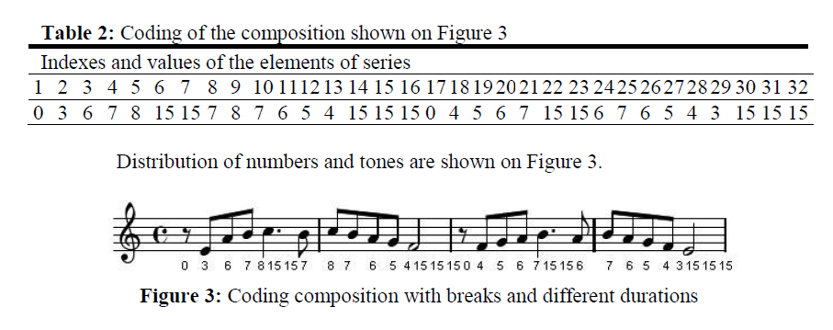
INDIVIDUAL
Notes:
4 bars, shortest length 8 times, 8x4=32 array length which describes the composition.

Slide 6
Initial population
Individuals with pre-defined rhythm that is similar to the reference individual
Reference individual used so that duration of notes do not depend on random generator
Reference individual determines parameters (tonality, bars, shortest length, etc.)
Notes:
Pre-defined rhythm: same distribution of beats
Etc = distribution of beats, number of shortest lengths in one beat

Slide 7

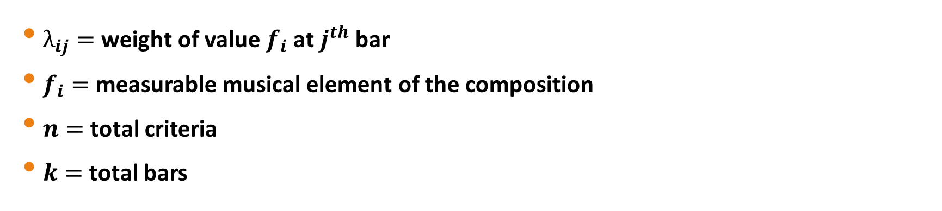
FITNESS
Distance between individuals calculated by number and type of “good” intervals and distribution of bars
$λ_{ij}=$ weight of value $f_{i}$ at $j^{th}$ bar
$f_{i}=$ measurable musical element of the composition
$n=$ total criteria
$k=$ total bars
Notes:
Different fitness functions, but music is subjective so subjective opinions can differ One example: weight x measurable musical elements of the composition
Fitness value affected by number of tones out of tonality, so more fit individual has less tones that do not belong to desired tonality

Slide 8
FITNESS
Represent each melody as an array of numbers
Evaluate the interval
For every bar, calculate arithmetic mean of intervals in the bar and variance of the two compositions
Lower fitness denotes more similarity in distribution of intervals
Notes:
Lower fitness value for better interval
Higher variance = different types of interval
Mean = average of the interval values in the bar
Variance = deviations in the interval

Slide 9
Mutation
Higher chances of mutating better individuals
3 types of mutation with their own probabilities:
Changing tone for an octave to reduce large intervals
Changing one tone to improve fitness
Swapping 2 consecutive notes
Notes:
1. Intervals larger than an octave are mutated

Slide 10
Selection
Individuals with same fitness are removed to have only 1 copy
Truncation selection
Notes:
Select one-third of total
Exploitative

Slide 11
EXPERIMENT and RESULTS
Tones are fixed and “good” and “bad” tones defined
Composition must consist of 4 bars with 32 total shortest lengths
Reference means and variance defined for each bar
Population size is mostly 30 with optimal solutions obtained at 100 generations
Solutions have different durations with frequent breaks
Solutions sound like good improvisations rather than melodic composition
Notes:
More breaks = less potential bad intervals which greatly decrease fitness value than good intervals can increase
Solutions too short to form a longer melody

Slide 12
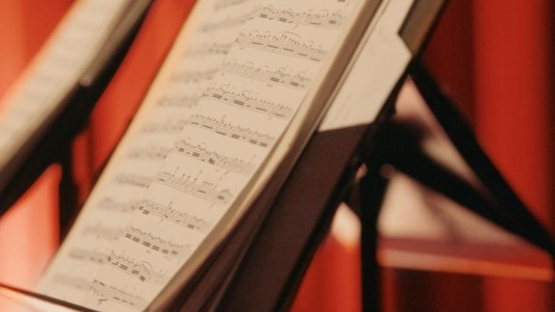
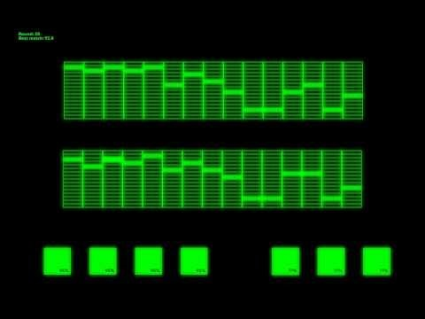
https://www.youtube.com/watch?v=ssH6Sxd4FQo

Slide 13
LIMITATIONS
1. Fitness functions subjectivity: human involvement at times to listen to the melody.
2. Lack of crossover function the algorithm is to generate relatively short compositions and it makes no sense to crossover so short pieces.
3. Best individual may not have good enough fitness if we start with a poor population.
Notes:
2. Three types of mutation and good balancing parameters for fitness give good results
3. Due to poor initial population but it is removed and second best individual becomes best

Slide 14
CONCLUSION
Results obtained by the algorithm meet some objective criteria of beautiful meaningful rhythms.
As seen, coding the composition by an array allows appropriate mathematical functions to be applied.
This research can be extended in several ways. It would be interesting to implement some other metaheuristic for comparison or hybridization with GA. By adjusting parameters in an appropriate way, it can be investigated how presented GA could generate compositions that all belongs to one particular music gender.

Slide 15
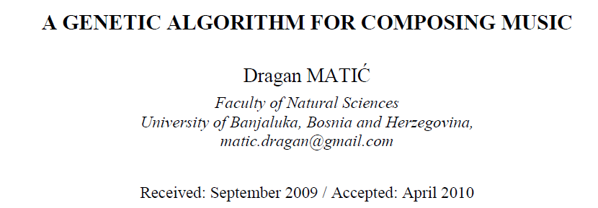
THANK YOU!

